Slide 1
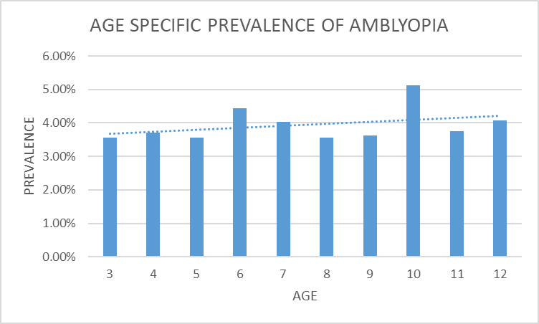
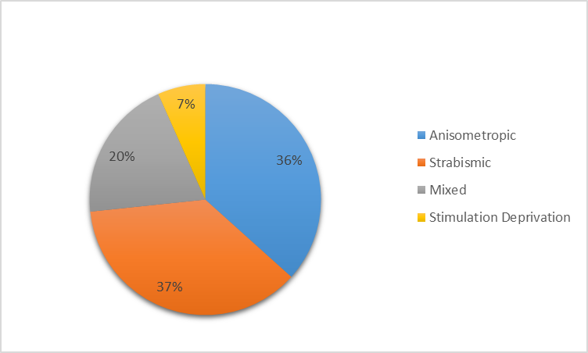
A study of amblyopia and its cause in paediatric patients visiting tertiary care centre
Author: Dr. Rutuja Brahmbhatt (2nd Year Resident, C.H. Nagri Eye Hospital)
Co-author: Dr. Anuja Bhatt (2nd Year Resident), Dr. Jayadatt Patel (Cornea Fellow), Dr. Reema Raval (Associate Professor), Dr. Kintu Shah (Assistant Professor)
C. H. Nagri Eye Hospital, Ahmedabad
Introduction
Result
Conclusion
Amblyopia is a form of cortical visual
impairment which can result from any
condition that prevents normal visual
stimulation in the first few years of
life.
Most amblyopia arises as a result of a
difference in refractive errors between
the two eyes (anisometropia), ocular
misalignment (strabismus or squint) or
a combination of these two factors.
It is usually unilateral and may go
unnoticed by the children and parents .
These conditions may co-exist but
treatments should be considered
separately.
Prevalence of amblyopia was found
to be around 4% which has
decreased as compared to some
national studies suggesting more
than 5% of prevalence in this age
group.
School health programs play an
important role in screening and
early detection.
These findings may help to
optimize the timing and modality of
preschool and school vision
screening programs.
Distribution according to pathology
Take home message
Pre-school screening may help
diagnose amblyopia earlier
providing better prognosis.
Aims and objectives
To determine the age specific
prevalence of amblyopia in children
aged 3 to 12 years and its associate
causes.
30 patients were found to be amblyopic of
which 21 were unilateral and 9 were cases of
bilateral amblyopia.
Strabismus remains to be the commonest
cause.
Refractive error was found to be an important
cause.
10 year age group was found to be the most
vulnerable group, but the possibility of school
health program referrals cannot be ruled out.
Prevalence is low in pre-school possibly due
to poor referral by family physicians.
Limitation
Small sample size
Long term follow-up not done
References
Method
Attebo K, Mitchell P, Cumming R, Smith W, Jolly N, Sparkes R. Prevalence and causes of amblyopia in an adult population. Ophthalmology. 1998;105(1):154–159
Holmes JM, Clarke MP. Amblyopia. Lancet. 2006;367 (9519):1343–1351.
Group M-ePEDS. Prevalence of amblyopia and strabismus in African American and Hispanic children ages 6 to 72 months: the multi-ethnic pediatric eye disease study. Ophthalmology. 2008;115(7):1229–1236
Friedman DS, Repka MX, Katz J, et al. Prevalence of amblyopia and strabismus in white and African American children aged 6 through 71 months: the Baltimore pediatric eye disease study. Ophthalmology. 2009;116(11):2128–2134
A cross-sectional study of 750 patients
visiting tertiary care center was carried
out for any cause of amblyopia and its
associated morbidities.
The examination included evaluation of
ocular alignment, refractive error,
ocular structures, orthoptic evaluation
as well as determination of visual acuity
in children.
The study was done to delineate age
specific prevalence of amblyopia and
its associated causes.
Discussion
Strabismus prevalence increases with age but
prevalence of amblyopia appears to be stable.
An early diagnosis will help in
reducing the burden of preventable
blindness.
The distribution of amblyopia in
anisometropia without strabismus and with
strabismus are equal in this age group.
Prevalence of Amblyopia remains relatively
constant with increase in age.

